Slide 1
Gamma-Ray Burst (GRB) Science with LST
Kunihito Ioka (KEK)
on behalf of the GRB subtask
CTA LST meeting 2010@RAL

Slide 2
GRB science with LST
Lower limit on the bulk Lorentz factor
G>1000 is important, usually not exp cutoff, not necessarily the same region
Emission mechanism: afterglow/prompt? Lepton(syn?/IC?)/hadron?
Spec: max synchro, IC component, Tempral: time-resolved
Long obs: early afterglow, Early obs: GeV onset delay (w/ precursor)
Probing EBL, High-z: LIV? Axion?, First star, ISM B
LIV (with CTA only)
Best scenario: Energy is dominated by TeV, no cutoff
Lorentz factor>10000, Violate EBL + LIV! + ICECUBE&GW!

Slide 3
GRB Subtask
inaugurated Mar. 18, 2010
Asano, Katsuaki
Falcone, Abe
Granot, Jonathan (Yoni)
Hinton, Jim
Horns, Dieter
Inoue, Susumu
Inoue, Yoshiyuki
Ioka, Kunihito
Kakuwa, Jun
Lamanna, Giovanni
Markoff, Sera
Murase, Kohta
O’Brien, Paul
Raue, Martin
Ryde, Felix
Tam, P. H. Thomas
Teshima, Masahiro
Toma, Kenji
Torres, Diego
Wagner, Stefan
Wijers, Ralph
Yamazaki, Ryo
Zech, Andreas
You are welcome to join us
j.granot@herts.ac.uk
inoue@tap.scphys.kyoto-u.ac.jp
pto@star.le.ac.uk
Red: Leaders

Slide 4
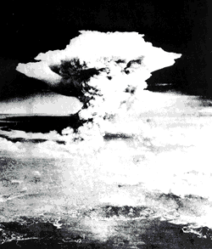
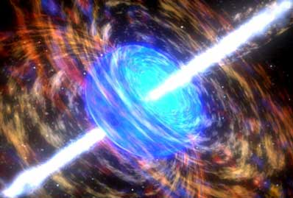
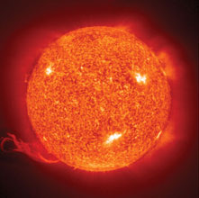
GRB: Brightest Explosion
E=mc² (by Einstein)
=
=
GRB
~10⁵²erg
Sun
~10³³g
Atomic bomb
~1kg
In ~sec, GRB release energy Sun emit over lifetime
GRB is the most luminous object

Slide 5
GRB in a Nutshell
Relativistic Jet
Γ>100
External
Shock
Internal
Shock
Photo-
sphere
ISM
E_{kin}⇒E_{γ}
Flux
~2-3/day@Cosmological
Long: Massive Stellar
Collapse to BH/NS
Short: NS-NS/BH merger?
Magnetar? Long GRB?
Afterglow
Prompt
~2-100s
~0.01-2s
Time

Slide 6
GRB Spectrum
Band spectrum
CTA
νF_{ν}
∝ν^{-0.5}
∝ν
E_{peak}
ν
keV
MeV
GeV
TeV

Slide 7
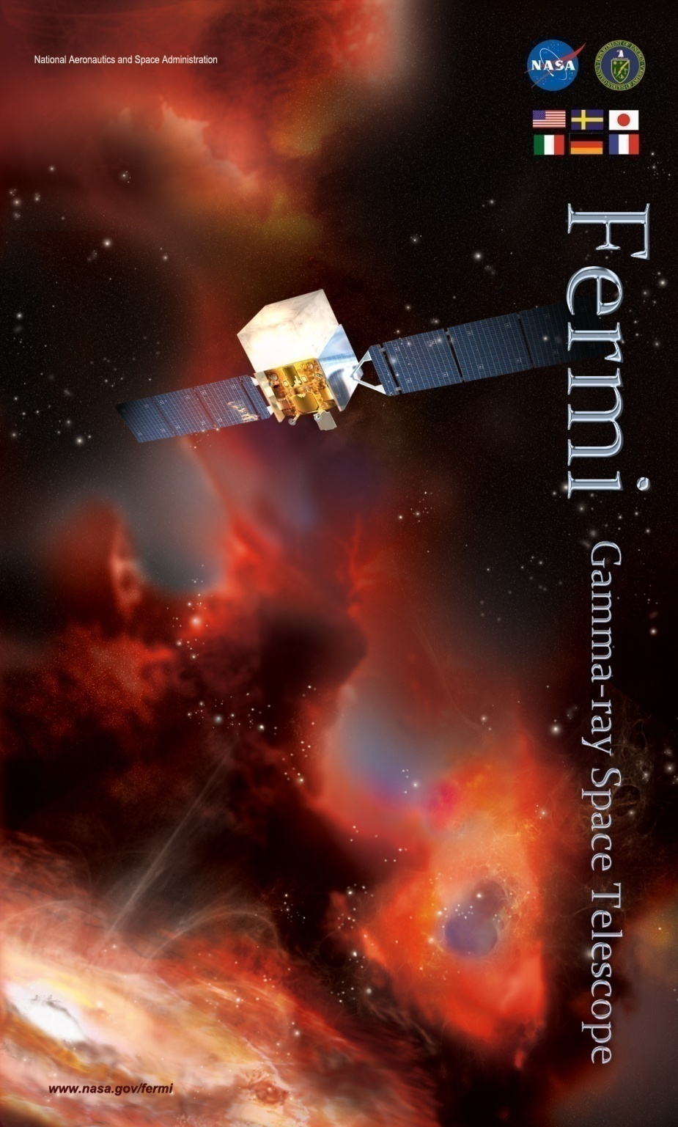
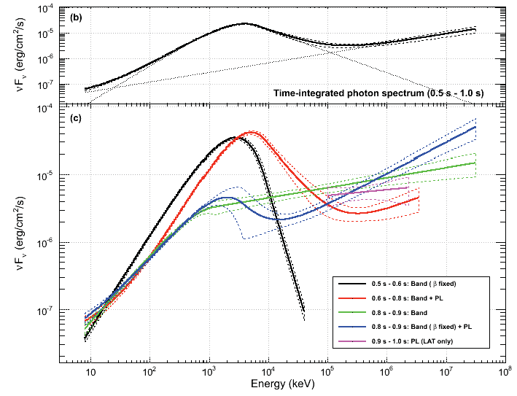
Fermi Revolution
~30 GeV γ from GRBs ⇒
Guaranteed source for CTA
GRB 090510
CTA
GeV
keV
MeV
Abdo+ 09

Slide 8
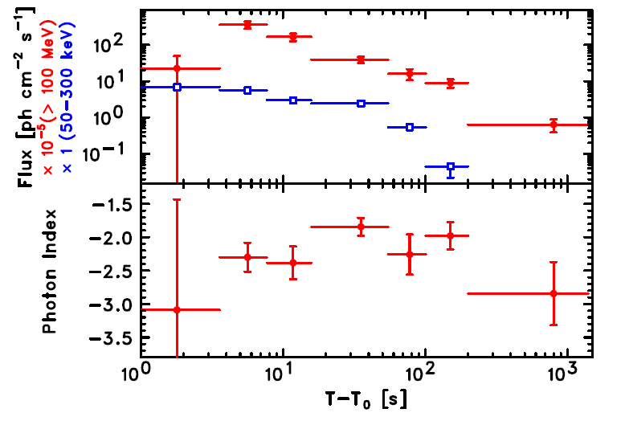
Fermi GRB Features
1. Extra spectral
component
2. Temporally
Extended
Emission
t^{−1.2±0.2}
GRB 090510
GeV
keV
MeV
GRB080916C
(But minor; majority is Band)
up to >1000sec

Slide 9
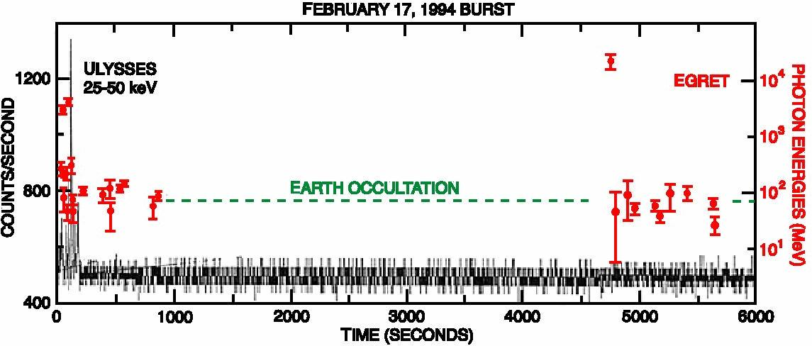
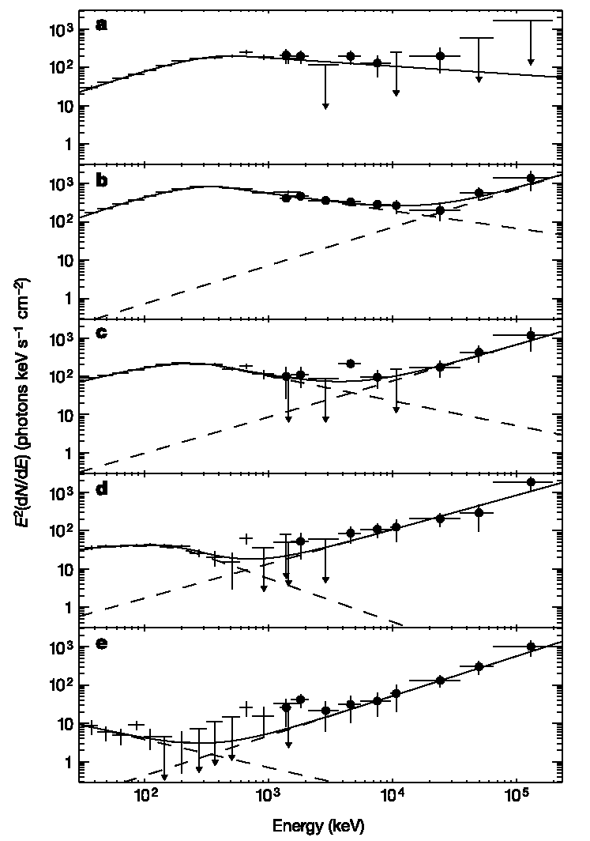
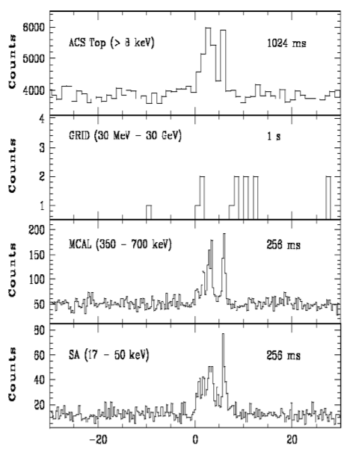
Pre-Fermi Era
EGRET
GRB940217 (Hurley+94)
18GeV to 90min
GRB941017 (Gonzalez+03)
Temporary distinct HE
AGILE
GRB080514B (Giuliani+08)
Long-lived HE

Slide 10
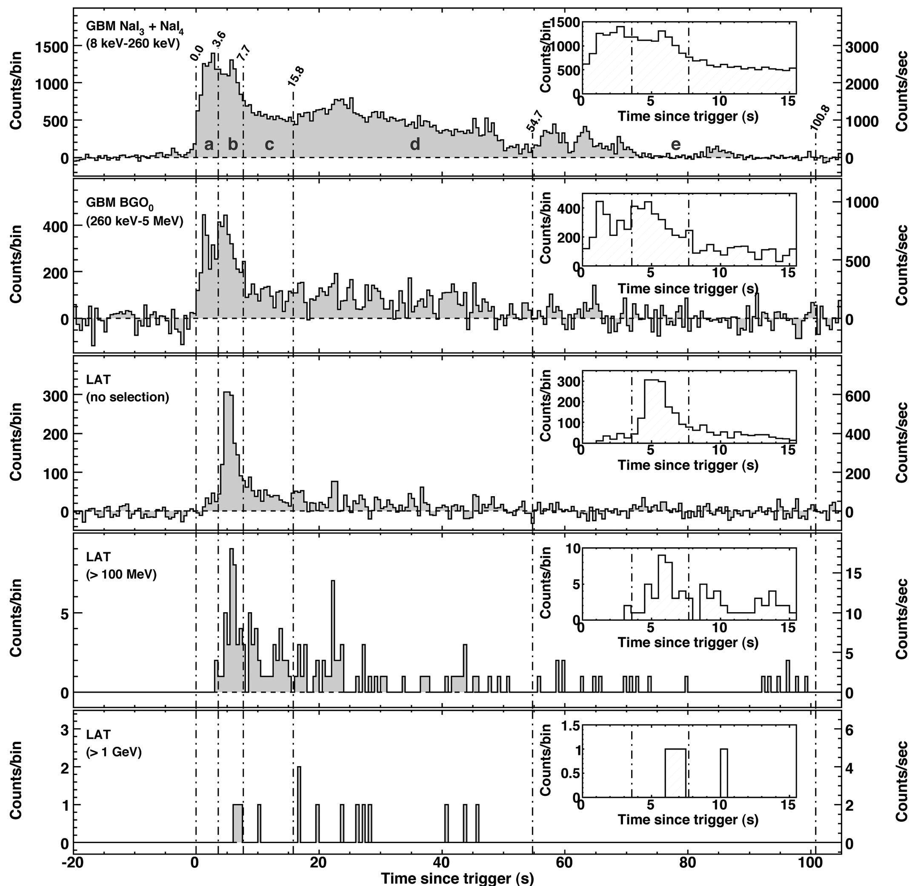
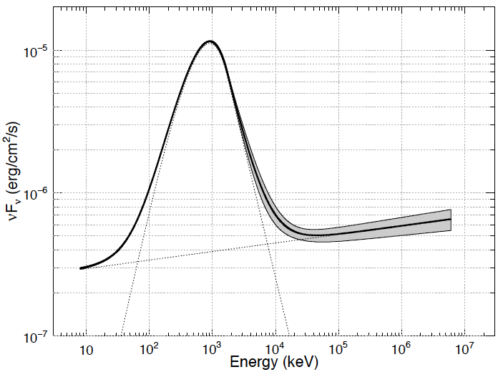
New Features
3. GeV onset delay
4. Photosphere-like
GRB 090902B
MeV
GeV
~1 sec
~ Black Body
(But minor)
Abdo+ 09

Slide 11
GRB | Angle from LAT | Duration (or class) | # of events > 100 MeV | # of events > 1 GeV | Delayed HE onset | Long-lived HE emission | Extra spectral comp. | Highest photon Energy | Redshift
080825C | ~ 60° | long | ~ 10 | 0 | ? | ✔ | X | ~ 600 MeV
080916C | 49° | long | 145 | 14 | ✔ | ✔ | ? | ~ 13.2 GeV | ~ 4.35
081024B | 21° | short | ~ 10 | 2 | ✔ | ✔ | ? | 3 GeV
081215A | ~ 86° | long | — | — | — | — | -- | —
090217 | ~ 34° | long | ~ 10 | 0 | X | X | X | ~ 1 GeV
090323 | ~ 55° | long | ~ 20 | > 0 | ? | ✔ | ? |  | 3.57
090328 | ~ 64° | long | ~ 20 | > 0 | ? | ✔ | ? |  | 0.736
090510 | ~ 14° | short | > 150 | > 20 | ✔ | ✔ | ✔ | ~ 31 GeV | 0.903
090626 | ~ 15° | long | ~ 20 | > 0 | ? | ✔ | ?
090902B | 51° | long | > 200 | > 30 | ✔ | ✔ | ✔ | ~ 33 GeV | 1.822
090926 | ~ 52° | long | > 150 | > 50 | ✔ | ✔ | ✔ | ~ 20 GeV | 2.1062
091003A | ~ 13° | long | ~ 20 | > 0 | ? | ? | ? |  | 0.8969
091031 | ~ 22° | long | ~ 20 | > 0 | ? | ? | ? | ~ 1.2 GeV
100116A | ~ 29° | long | ~ 10 | 3 | ? | ? | ? | ~ 2.2 GeV
Detections as of 090904
Detections as of 090904
©Ohno
~18 LAT+GMB (as of Jul 2010): No HE cutoff

Slide 12
Exception
GRB 090926A
10 10² 10³ 10⁴ 10⁵ 10⁶
E_{γ} (keV)
Abdo+ 10
Spectral break @~1.4GeV
Γ~200-700 if break is due to γγ

Slide 13
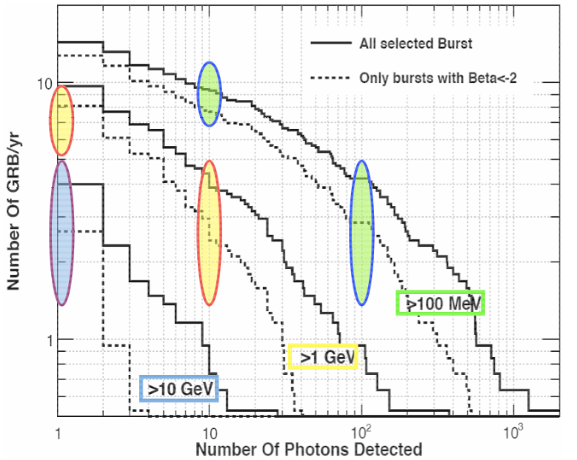
Implication of LAT Rate
Comparable to
estimates based
on extrapolated
BATSE GRBs
no HE excess
nor deficit
(But,
D. Kocevski
@GRB2010)
Band is OK
Extra com.
is rare
Band+ 09

Slide 14
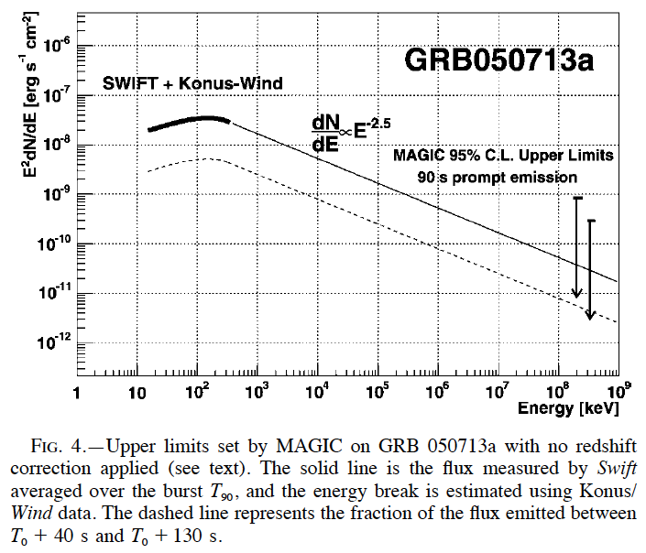
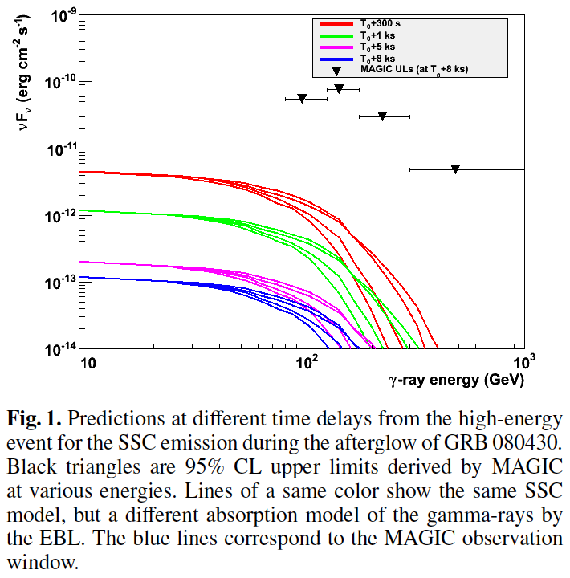
MAGIC
Albert+ 06
Aleksic+ 10
MAGIC is consistent with the Band extrapolation

Slide 15
LST sensitivity
Low energy
(<200GeV)
sensitivity is
determined
by LST
Konrad Bernlöhr
@Zeuthen10

Slide 16
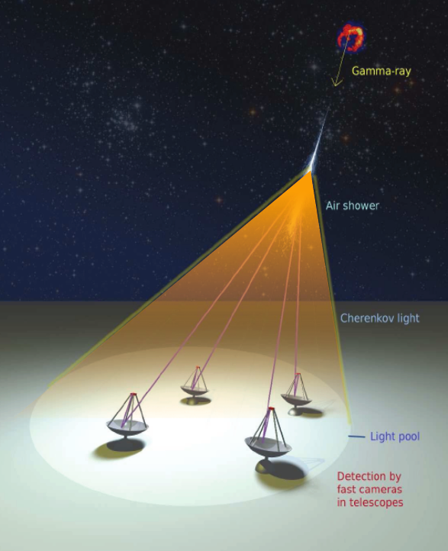
More γ than Fermi
Huge Effective Area
Fermi ~1m² @>10GeV
CTA ~10⁴m² @30GeV
Expected # of γ
(0.1-1)γ x (10⁴m²/1m²)
~ 10³-10⁴ γ per GRB!
: Great Advantage of CTA
~Background (but >30σ CL)
~10kHz data taking is necessary

Slide 17
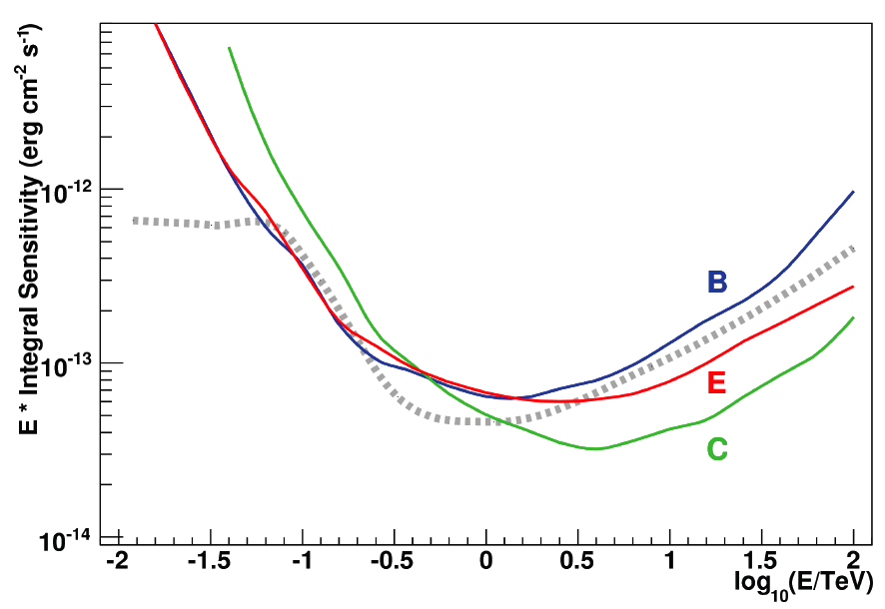
Energy Threshold
Extragalactic Background Light + Sensitivity
γ_{GRB}(100GeV) + γ_{EBL}(10eV) → e⁺ + e⁻
Sensitivity [arbitrary]
Low Energy
Sensitivity is
CRUCIAL
Signal
(Schematic)
S. Inoue’s talk
in this CTA meeting

Slide 18
Rough Event Rate
Fermi LAT(GeV)/GBM(MeV) ~ 0.1
~1000/yr x (LAT/GBM) ~ 100/yr (Conservative)
GRB in the FOV
~100/yr x (Duty 0.1) x (FOV 5deg²) ~ 0.03/yr
Follow-up
Extended GeV emission lasts for >1000 sec
~20 sec slews are enough
~100/yr x (Duty 0.1) x (Zenith 0.1) ~ 1/yr
GRB subtask (J. Kakuwa) is refining the estimate

Slide 19
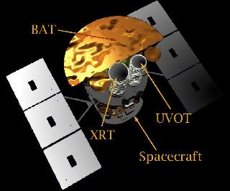
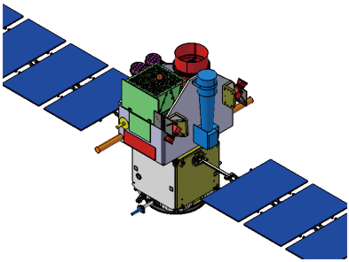
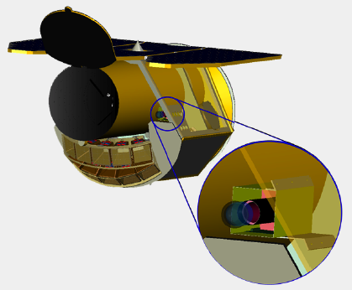
Alert for Follow-up
SVOM
~2015-?
(approved)
Swift
up to ~2015?
JANUS
~2016-?

Slide 20
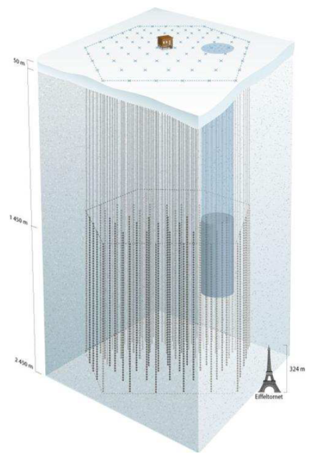
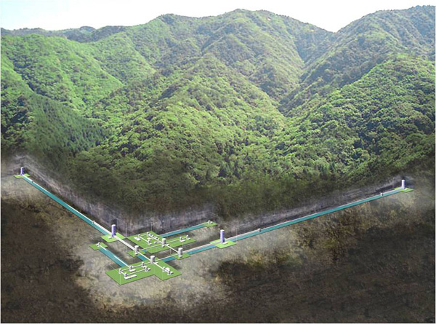
Upcoming New Windows
High Energy ν
Gravitational Wave
LIGO, Virgo, GEO,
LCGT, AIGO, LISA,
DECIGO/BBO
IceCube, KM3Net
Notes:
New windows to the universe is also almost opening through the high energy neutrino as well as gravitational wave channels.

Slide 21
GRB Science with CTA
TeV calorimetry
Lower limit on the bulk Lorentz factor
Emission mechanism
Site? Leptonic(syn?/IC?)/Hadronic?
Cosmology
Probing EBL, B
Lorentz Invariance Violation (w/ CTA only)
…

Slide 22
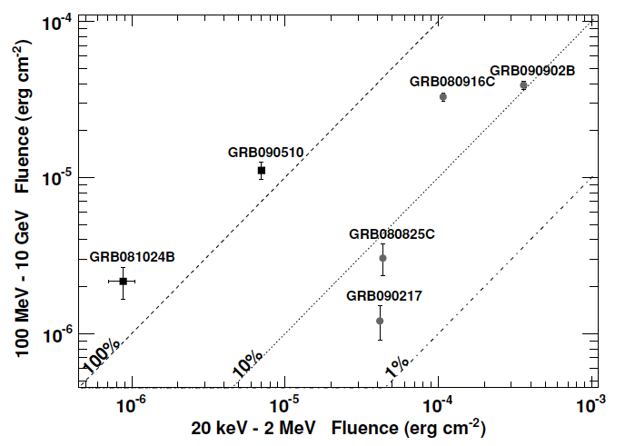
1. TeV Calorimetry
Energetics may be determined by TeV γ
νF_{ν}
Short GRB
IC/Syn~ε_{e}/ε_{B}>1
E>10⁵²erg
⇒ NS origin
Abdo+ 10

Slide 23
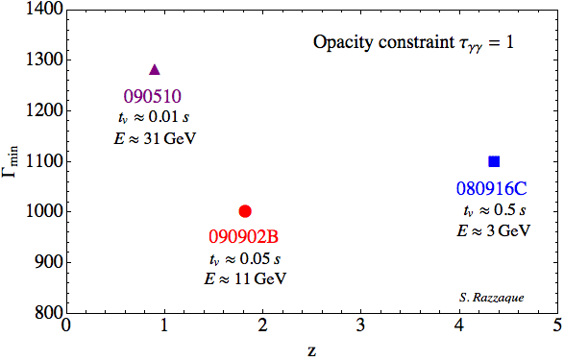
2. Lower limit on bulk Γ
γγ→e⁺e⁻ (ε_{th}~MeV)
R~cΔt ⇒ τ~σ_{T}N_{γ}/4πR²≫1 (γ-ray cannot escape)
Relativistic
R~Γ²cΔt
Blueshift
τ~Γ^{2β-2}~Γ⁻⁶
Γ>10³!
v>0.999999×c
Γ_{min}
But see also Li 08, Granot+08, Bosnjak+09, Aoi+KI 10, Zou+10
Redshift

Slide 24
Conventional Γ_{max}
Fireball expands by radiation pressure
In principle, Γ_{max} ~ Energy / Mass
Mass↓Γ_{max}↑… However,
⇒ Transparent before Γ~Γ_{max}
Paczynski 86
Goodman 86
Shemi & Piran 90
Meszaros & Rees
Matter
Radiation
escapes

Slide 25
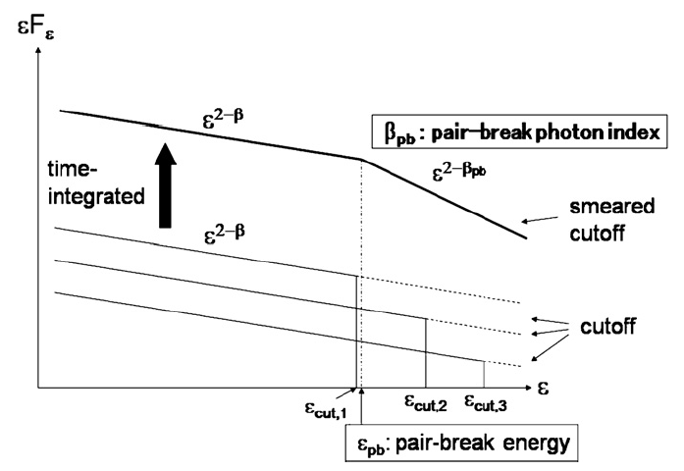
γγ→e⁺e⁻ Annhilation Break
Most likely Break (not Cutoff)
Time/Space
integration
smears
the cutoff
High-statistical
data or
Time-resolved
spectrum is
important
Aoi+ 10, Li 08,
Granot+08, Bosnjak+09

Slide 26
3. Emission Mechanism
Relativistic Jet
Γ>100
External
Shock
Internal
Shock
Photo-
sphere
ISM
Site
Mechanism
Syn? BB? Hadronic?
Composition
p? Poynting? γ? Fe?
E_{kin}⇒E_{γ}
Flux
Afterglow
Prompt
~2-100s
~0.01-2s
Time

Slide 27
GeV Models
External shock – long-lived, but not variable
Synchrotron (adiabatic/radiative shock)
SSC
External Compton of prompt γ
Internal shock
Synchrotron (peak at MeV) – not extra comp.
SSC – no low energy excess
Hadronic – proton luminosity is too large
External Compton of cocoon/photospheric γ – May need fine tuning
Synchrotron (peak at GeV-TeV) w/ High Γ

Slide 28
Possible TeV Features
γγ→e⁺e⁻ annhilation break
IC component
Max. Synchrotron Energy (t_{acc}=t_{cool})
Max. Synchrotron Energy (t_{acc}=t_{dyn})
How to separate
these from EBL abs.?
KI 10

Slide 29
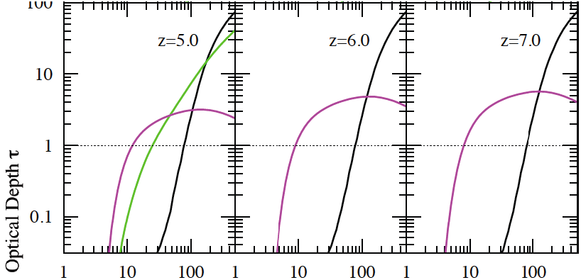
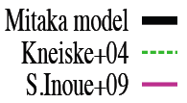
EBL
Y. Inoue+ 10
EBL has a large uncertainty
Probe of early star/galaxy formation
GRB 090423
@ z~8.2

Slide 30
Intergalactic B
Opt-UV
B
CMB
Delay
TeV γ
e±
GeV γ
MeV γ
z=10
B=10⁻¹⁵G
Delay time
⇒ B
But, could be
contaminated
by afterglow
Proga 95
Takahashi+ 10

Slide 31
LIV

Slide 32
Summary

Slide 33
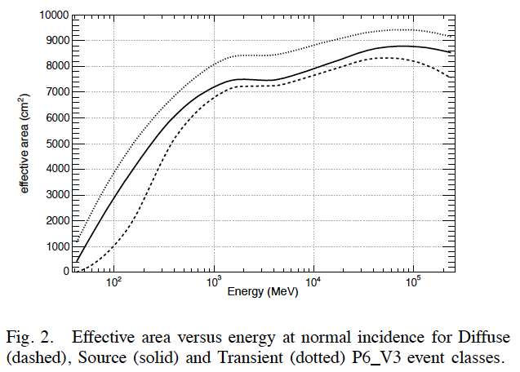
Rondo+ arXiv:0907.0626

Slide 34
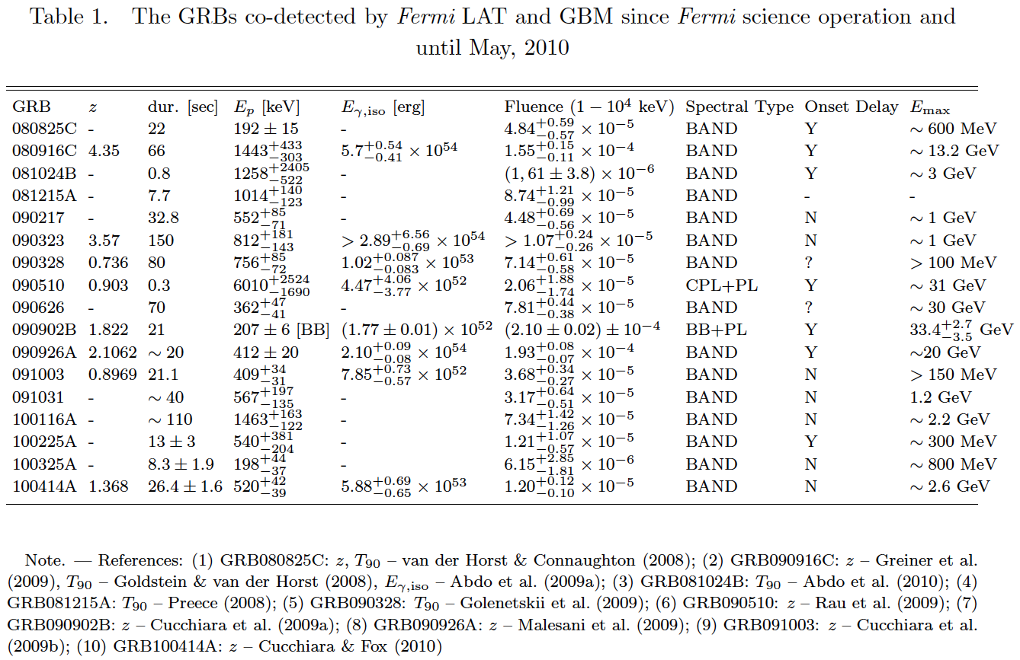
Zhang+ 10
~18 LAT+GMB GRBs (as of Jul 2010)
No HE cutoff within the sensitivity

Slide 35
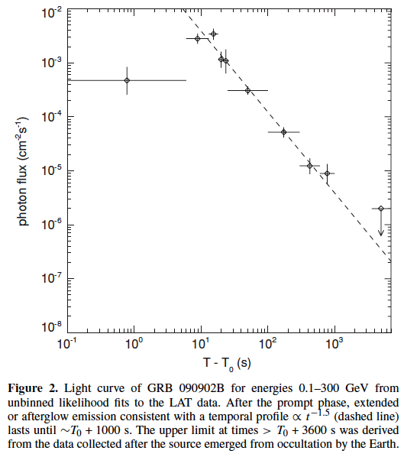
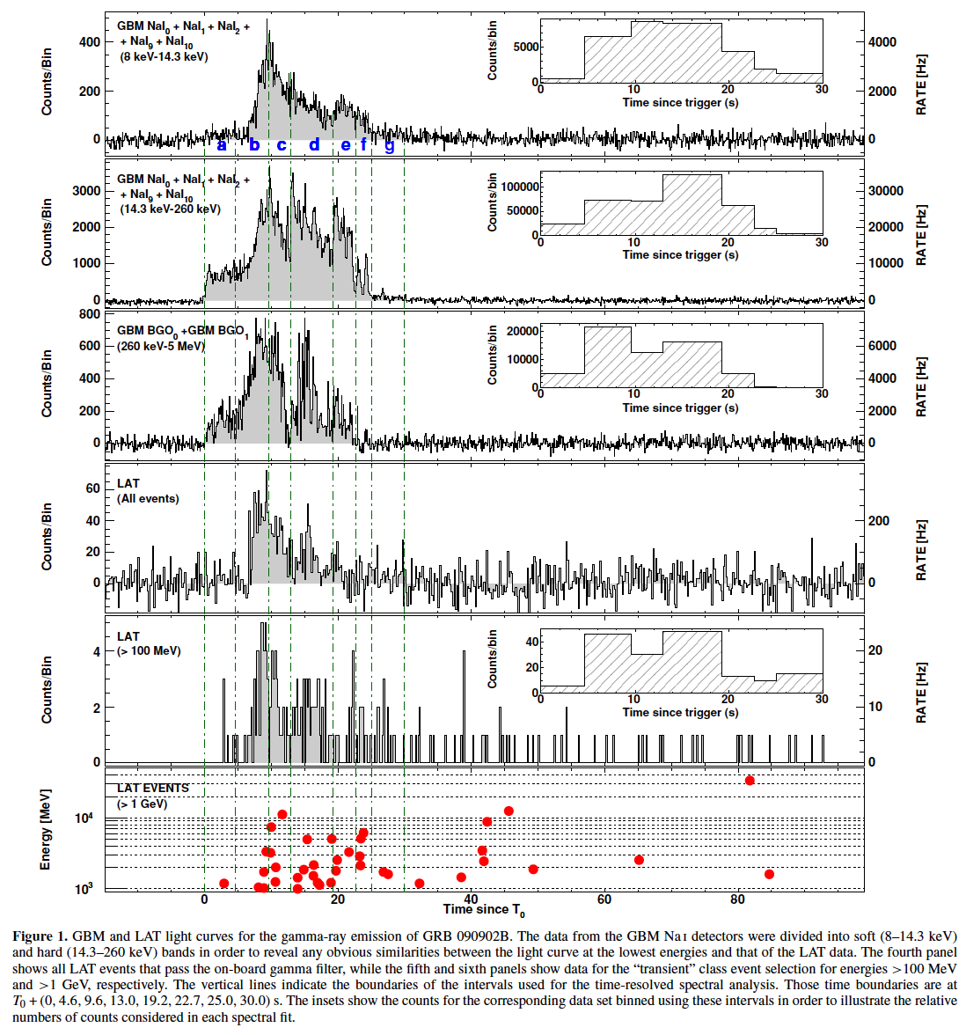
090902B
Abdo+ 09

