Slide 1
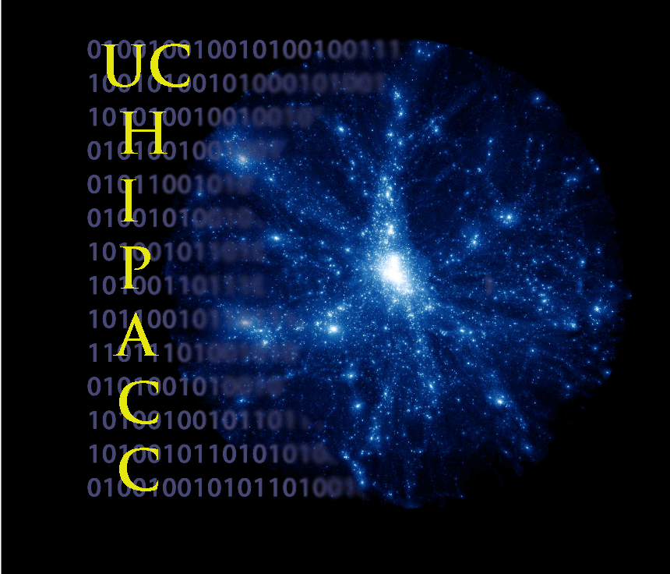
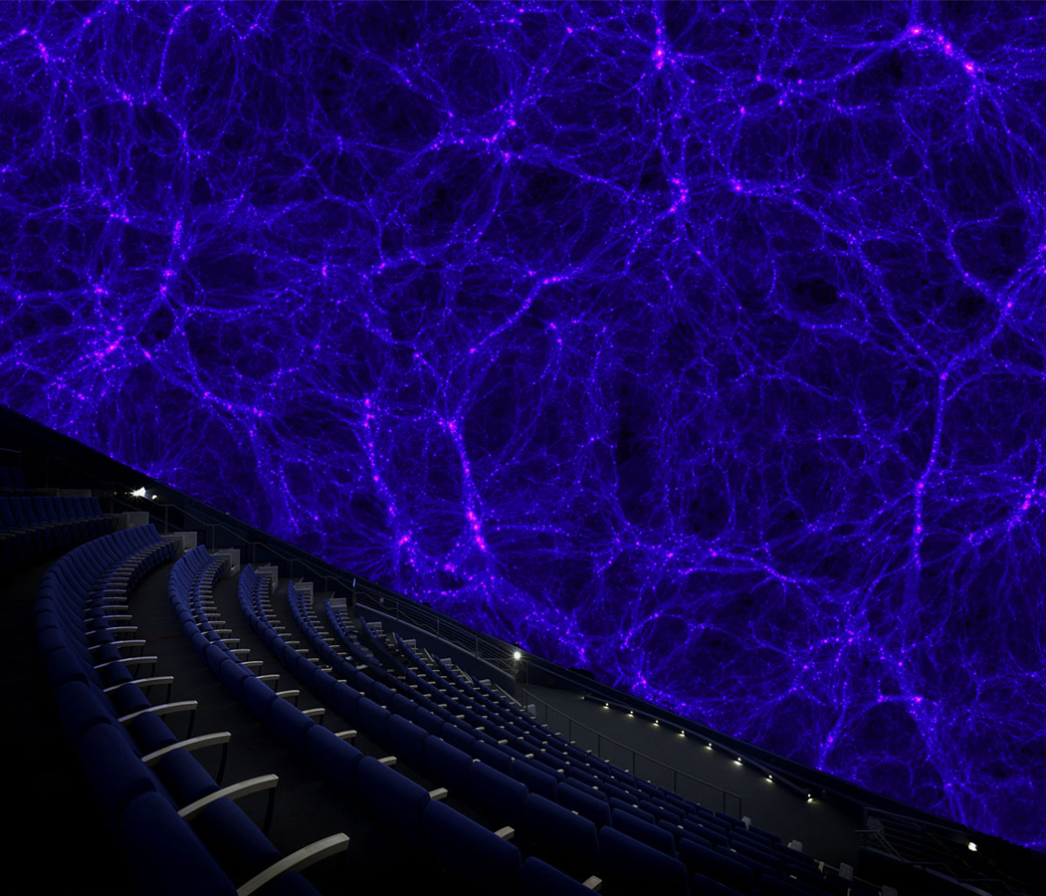
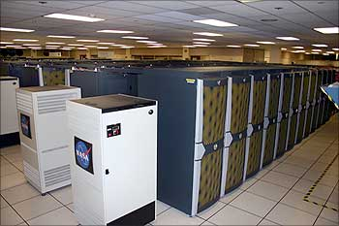
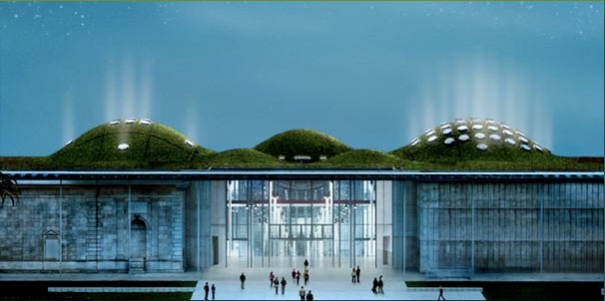
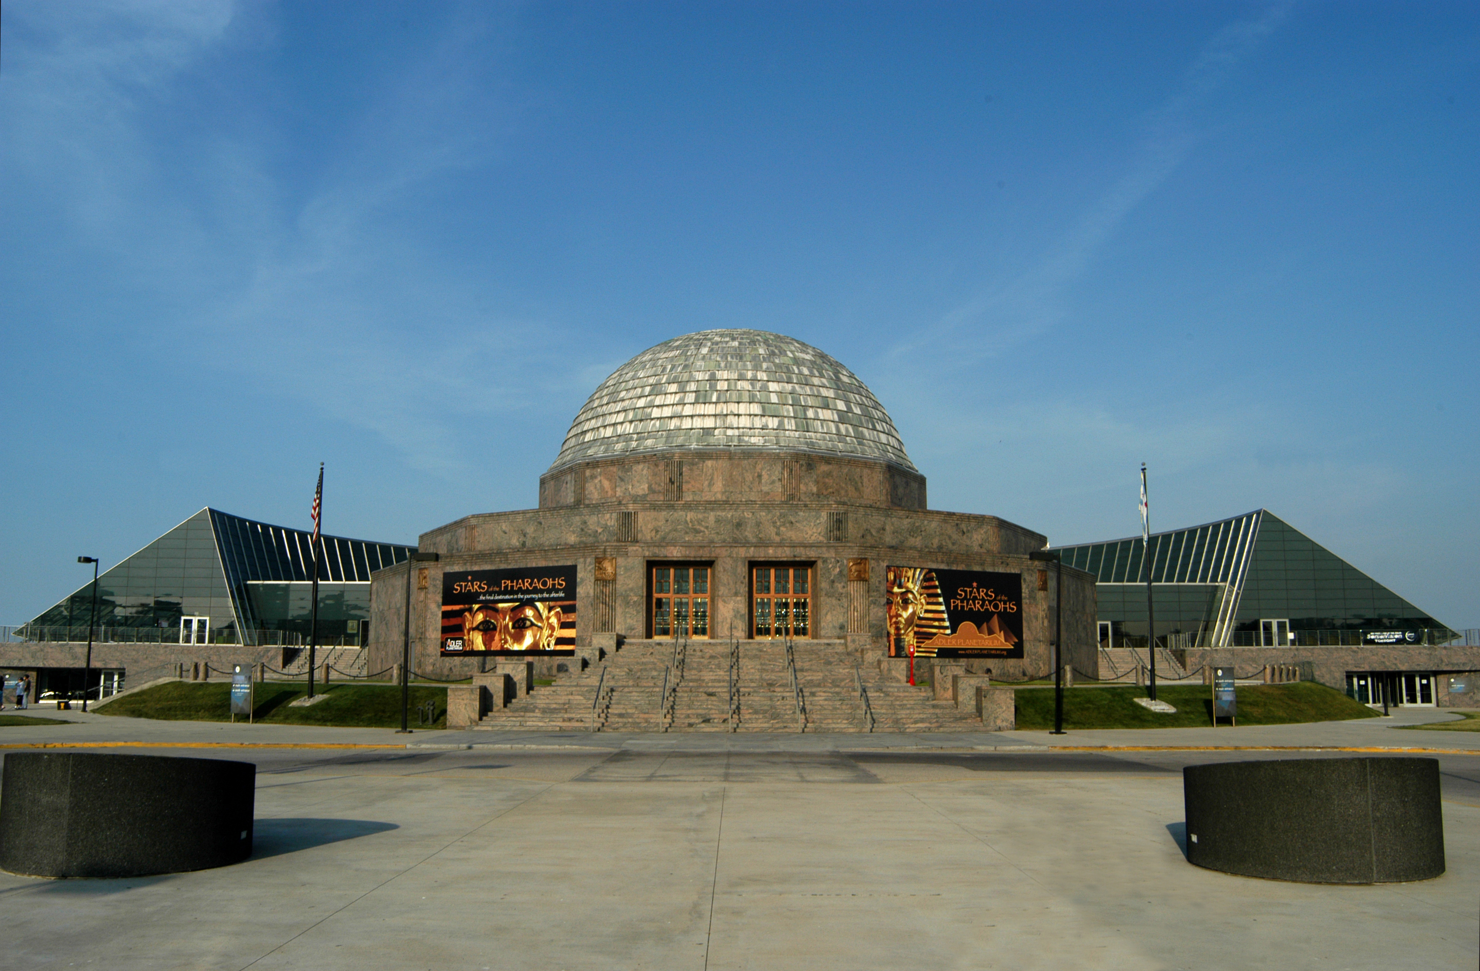
Astro-Computation Visualization and Outreach
Project lead: Prof. Joel Primack, Director, UC High-Performance AstroComputing Center
UC-HIPACC Visualization and Outreach Specialist: Nina McCurdy
Pleiades Supercomputer
NASA Ames
California
Academy of Sciences
Adler Planetarium
Chicago
HIPACC is working with the Morrison Planetarium at the California Academy of Sciences (pictured here) to show how dark matter shapes the universe. We are helping prepare their planetarium show opening fall 2010, and also working on a major planetarium show to premiere at the Adler Planetarium in spring 2011.

Slide 2
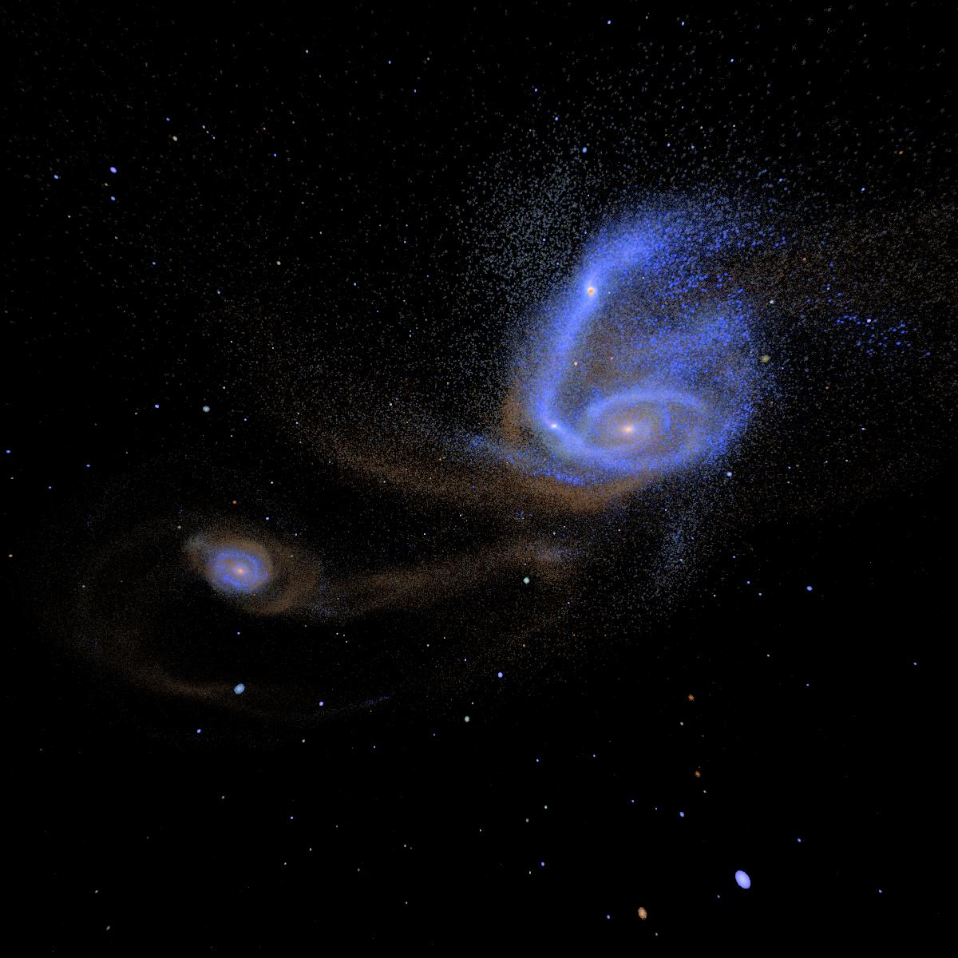
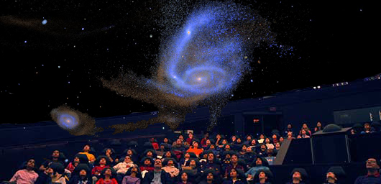
Galaxy Merger Simulation
Run on Columbia Supercomputer at NASA Ames Research Center.
Dust simulated using the Sunrise code (Patrik Jonsson, UCSC/Harvard).
Astronomical observations represent
snapshots of particular moments in time;
it is effectively the role of astrophysical
simulations to produce movies that link
these snapshots together into a
coherent physical theory.
Showing Galaxy Merger
simulations in 3D will
provide a deeper, more
complete picture to the
public and scientists alike.

Slide 3
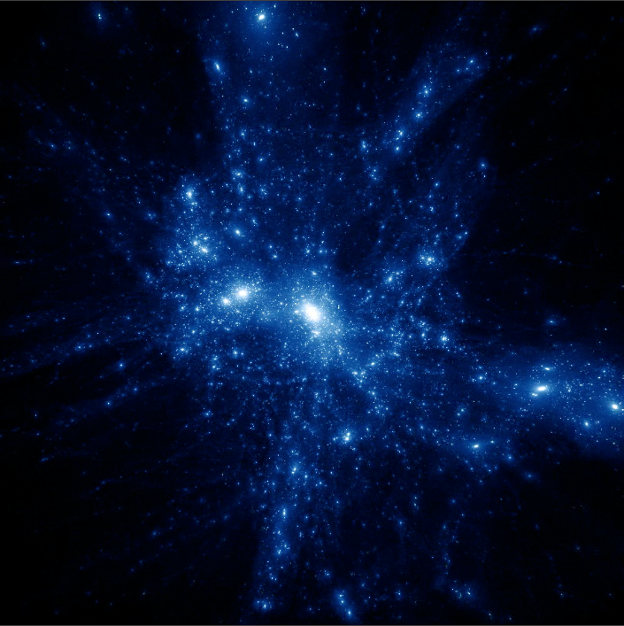
Cosmological Simulation of the Large Scale Structure of the Universe
The Bolshoi Simulation (ART code, 250 Mpc/h box,
latest cosmological parameters, 8 billion particles,
6 million cpu-hours on NASA’s Pleiades computer)
Visualization of Bolshoi by Chris Henze at NASA Ames
The visible material in the universe – stars, gas, dust, planets, etc. – accounts for only about 0.5% of the cosmic density.
The remaining 99.5% of the universe is invisible. Most of it is non-atomic dark matter (~23%) and dark energy (~72%),
with non-luminous atomic matter making up ~4%. In order to describe the evolution and structure of the universe, it is
essential to show the distribution of dark matter and the relationship of dark matter to visible structures.

