Slide 1
star formation recipes in semi-analytic models
rachel somerville
Rutgers University
work in progress with Gergo Popping, Scott Trager, Mike Berry, Ari Maller
& Eric Gawiser
August 8 2012

Slide 2
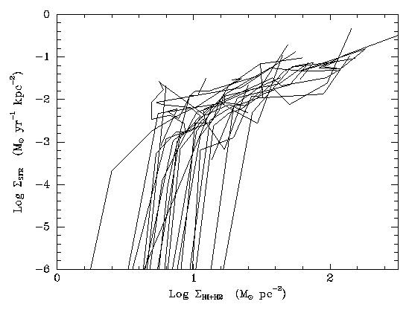
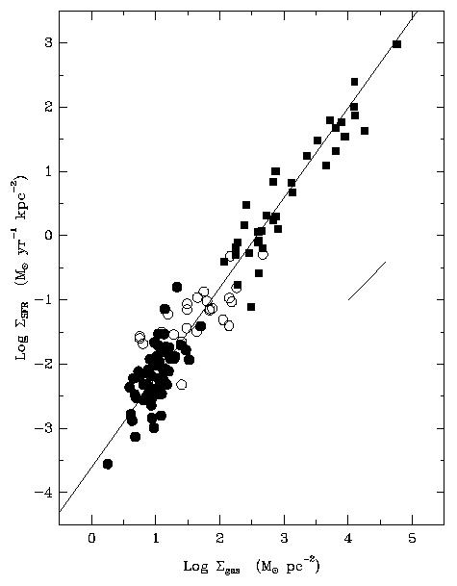
“Kennicutt Law”
.
Σ* = C Σ_{g} ^{1.5}
above critical threshold
Kennicutt 1989, 1998;
Martin & Kennicutt 2001

Slide 3
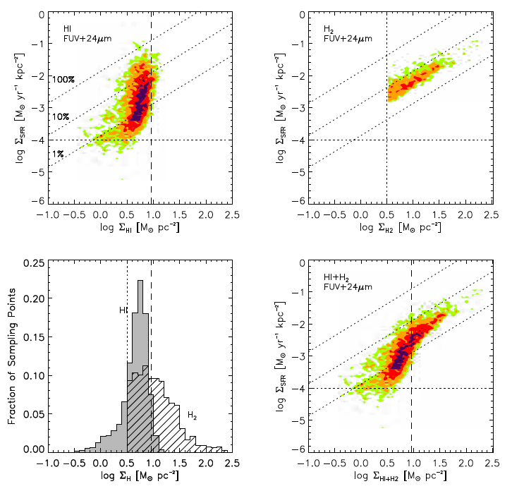
beyond Kennicutt
star formation
correlated with
density of
molecular
hydrogen;
almost no
correlation with
HI
Bigiel et al. 2008; Leroy et al. 2008

Slide 4
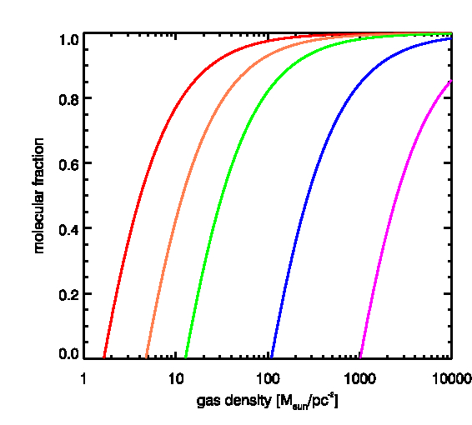
Tracking molecular hydrogen
H₂ fraction depends on gas density, amount of dust (metallicity) and intensity of UV radiation
Z=1.0
0.3
0.1
0.01
0.001
see also
Gnedin & Kravtsov 2010;
Robertson & Kravtsov 2009
Krumholz, McKee & Tumlinson 2008a,b, 2009
McKee & Krumholz 2010; Krumholz & Dekel 2011

Slide 5
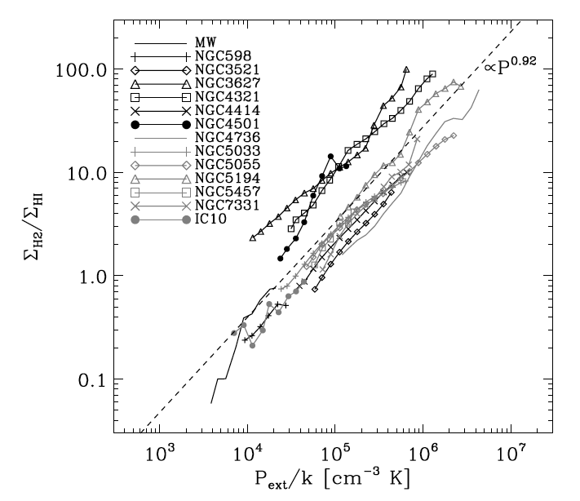
H2 as function of mid-plane pressure
Blitz & Rosolowsky 2006

Slide 6
Implementation in SAM
disk sizes modelled using standard angular momentum conservation arguments + adiabatic contraction
assume that total gas radial density distribution within each disk is described by an exponential
dust-to-gas propto cold-phase metallicity; IGM “pre-enriched” to 10⁻³ Z_{sun} by Pop III stars
compute f(H₂) and corresponding SFRD at each timestep (do not track formation/consumption/destruction)
stars form in H2 with ~constant efficiency/timescale (Bigiel et al. 2008)
rss, Popping & Trager; Popping, rss & Trager in prep

Slide 7
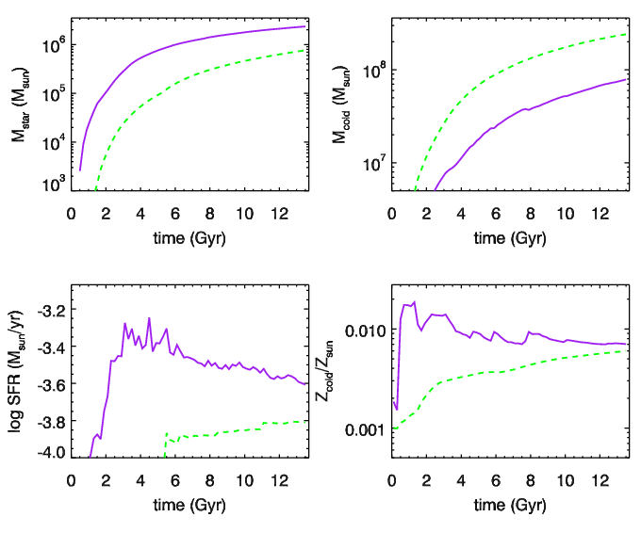
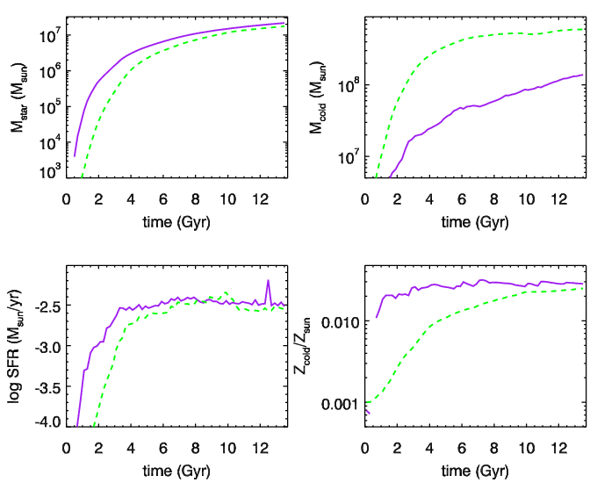
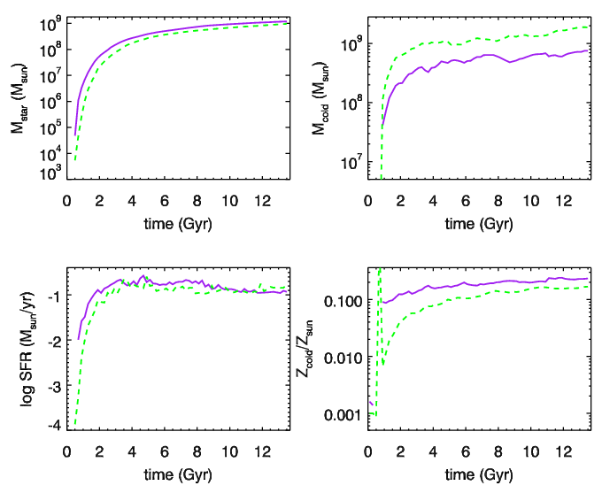
Mh=2.0E09
1.0E10
1.0E11
purple=standard Kennicutt
green=Z-dependent SF recipe
rss, Popping & Trager in prep

Slide 8
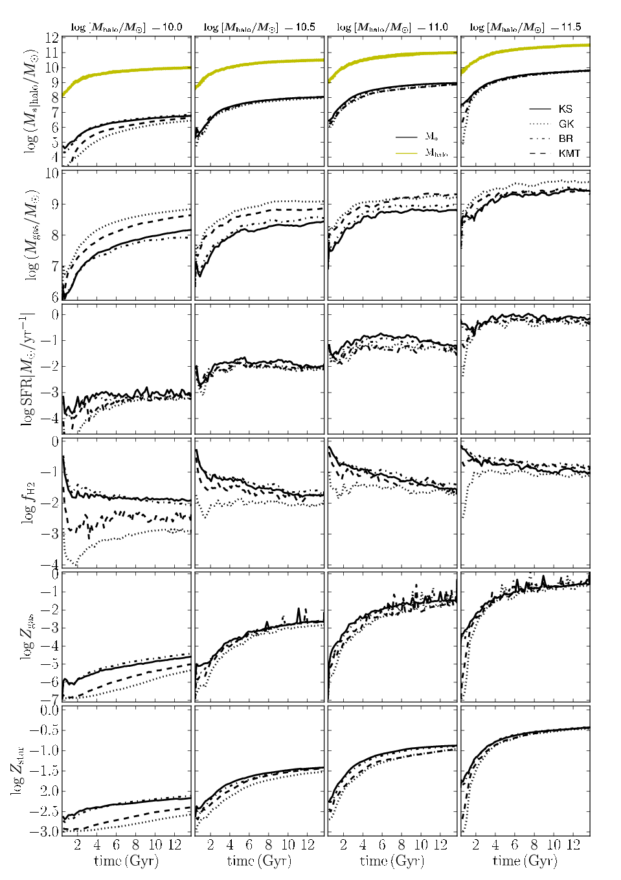
results shown here
are preliminary:
bottom line is that
pressure vs. Z-based
recipes do not differ
greatly in mass/redshift
range relevant to
CANDELS;
pressure-based tend
to predict more
efficient SF in low-mass
halos and at high-z
m_star
m_gas
SFR
molecular
fraction
we are in process of
testing sensitivity to
‘primordial’ H2 or
metallicity ‘floor’
gas
metallicity
stellar
metallicity
rss, Popping & Trager
in prep

Slide 9
match scaling relations for HI and H2 at z=0
Popping, rss
& Trager in prep
observations
from THINGS
and COLDGASS

Slide 10
cold gas mass functions z=0
atomic hydrogen
molecular hydrogen
log m*<1.0E08
Vc<50 km/s
observations: Martin et al. 2010 (ALFALFA); Keres et al. 2003
Popping, rss & Trager in prep

Slide 11
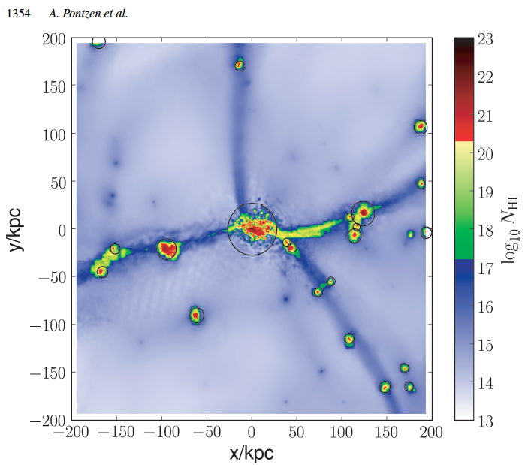
What about ionized gas within halos/galaxies?
Pontzen et al. 2008
simple model: all gas below
a critical surface density
(above & below disk, and
in outer disk) is ionized by
the external background
+constant fraction is ionized
by internal sources
(stars+HI+H2)/(stars+HI+H2+HII)
Gnedin 2011
sims w/ RT

Slide 12
SHMF basically unchanged (due to self-regulated SF)
-still require very strong stellar-driven outflows to match stellar mass function
-still overproduce stellar fractions/numbers of low mass galaxies @ high-z
z=1
Moster z=0
Moster z=1
Kennicutt
Z-dep H2 w/o
accounting for HII
Z-dep H2 w/HII
accounting
see also Fontanot et al. 2009
Santini et al. 2011
Guo et al. 2011
Fu, Kauffmann et al. 2012
Caviglia, rss et al. in prep
n.b. “root halo” mass limit 5.0E08 M_{sun}, followed
down to 5.0E06 M_{sun}
rss, Popping & Trager in prep

Slide 13
sSFR’s too low at low z and too high at
high z…sSFR vs. mass relation too flat
at all redshifts…
Z-dep H2 model with HII accounting
slope ~traces specific gas accretion rate
see also
Dutton et al. 2008
Weinmann et al. 2011
contrast Krumholz & Dekel 2011
rss, Popping & Trager in prep

Slide 14
global stellar mass assembly and star formation history
new models appear better…but misleading because we have actually reduced the
number of high mass galaxies at high redshift, in conflict with observations
Kennicutt
Z-dep H2 w/o HII
Z-dep w/HII
rss, Popping & Trager in prep

Slide 15
models appear to consume or expel
too much gas at high redshift
“goddess”-eye view of cold gas
gas from mock DLA “observations”
Berry, rss, Maller & Gawiser in prep
HI
Z-dep SF
Z-dep SF w/ HII accounting
H2

Slide 16
gas appears to get enriched too early--
this is alleviated in new models with
Z-dep H2-based SF recipe and by doing
mock DLA-selection
goddess-eye view
DLA-selected view
Berry, rss et al. in prep
Kennicutt
Z-dep H2 w/o HII
Z-dep w/HII

Slide 17
Summary
we have now implemented three new “H2-based” star formation recipes in the “Santa Cruz” SAM: two Z-dependent and one pressure-dependent.
the good news: 1) most predictions (especially those relevant for CANDELS) are robust. 2) we can now make predictions for different gas phases and their evolution with redshift. so far agreement with available observations appears good. 3) new recipes help alleviate ‘too early’ enrichment
the bad news: the new recipes do not help much to resolve the well-known discrepancies with observations of low-mass galaxies

Slide 18
summary of problems with the current paradigm
no model simultaneously reproduces f*(M_{h}), f_{gas}(m*), and sSFR(m*) at any redshift
stellar population ages at z=0 too old for low mass galaxies (rss et al. 2008; Fontanot et al. 2009)
low mass galaxies too numerous at high-z; low-mass halos at high-z have stellar fractions that are too high
specific star formation rates too low at low z and too high at high z; no sSFR plateau at high z
low mass galaxies become chemically enriched too early
not enough cold gas at high redshift (z>3) – gas being consumed or expelled too efficiently?

Slide 19
standard star formation recipe
Kennicutt relation with surface density cutoff:
.
S08: fixed surface density Σ_{crit} ~ 3-6 M_{sun}/pc²
Croton et al./de Lucia et al.: radially dependent Σ_{crit}
based on Toomre Q; Σ_{crit} ~ V_{c}/r for flat rotation curve

Slide 20
large scale galactic outflows
energy from SNae and massive stars assumed to drive large-scale outflows which remove cold gas from the disk, thus making it (temporarily) unavailable for SF
α=1 “momentum driven”
α=2 “energy driven”
typically ε~1-2
V₀~200 km/s
Kauffmann et al. 1994; rss & Primack 1998
Murray, Quataert & Thompson 2005
Oppenheimer & Dave’ 2007

Slide 21
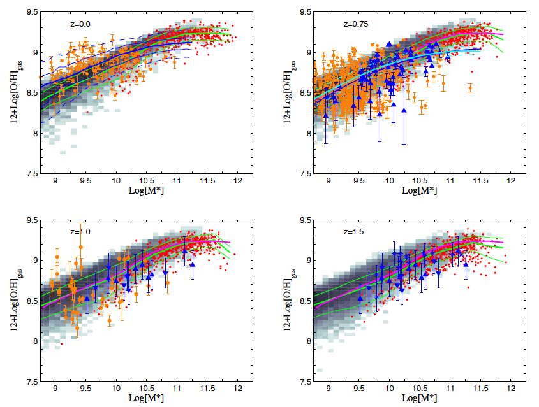
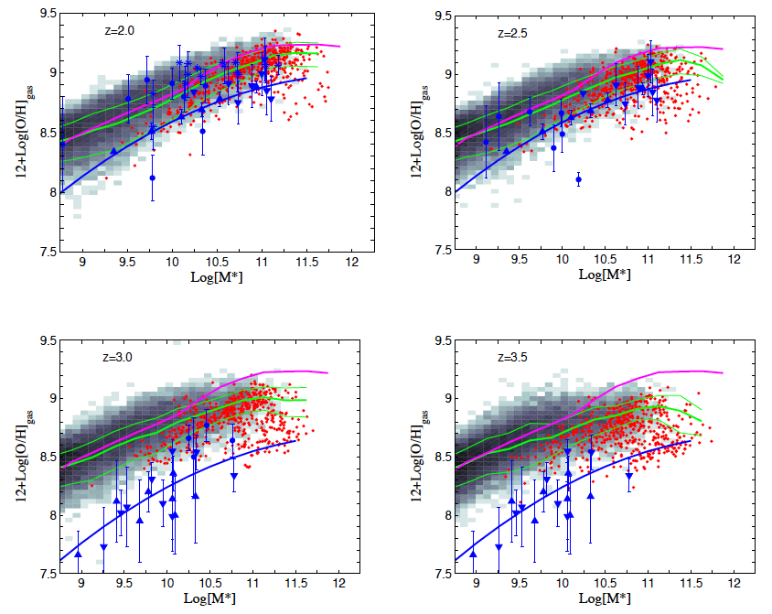
Galactic Chemical Enrichment
models (SNae II & Ia) coupled
with SAM
(low mass) model galaxies appear to
be too enriched at high redshift
(these results are for the “classical
Kennicutt” model)
Arrigoni, Trager, rss & Popping 2012

Slide 22
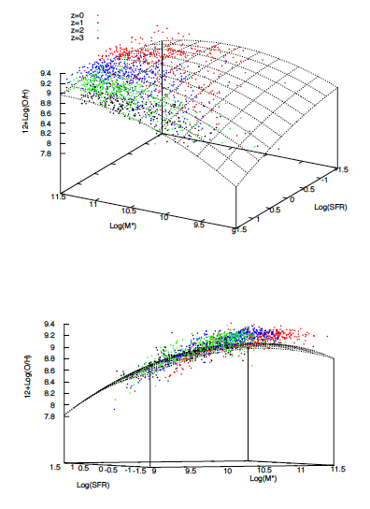
but interestingly, the model galaxies
do seem to lie on (and evolve along)
the “Fundamental M-Z-SFR Plane”
(Mannucci et al. 2010)!
Arrigoni, Trager, rss & Popping 2012

Slide 23
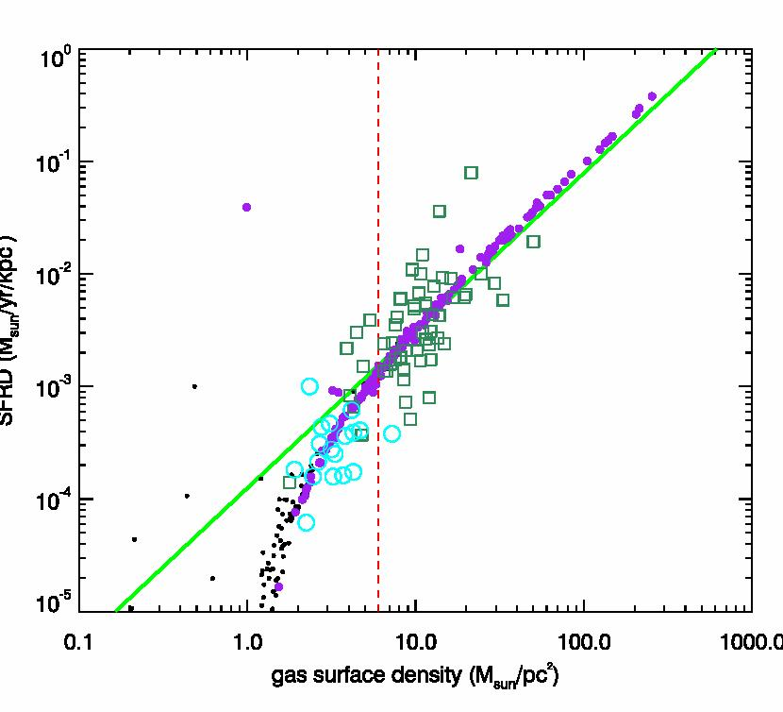
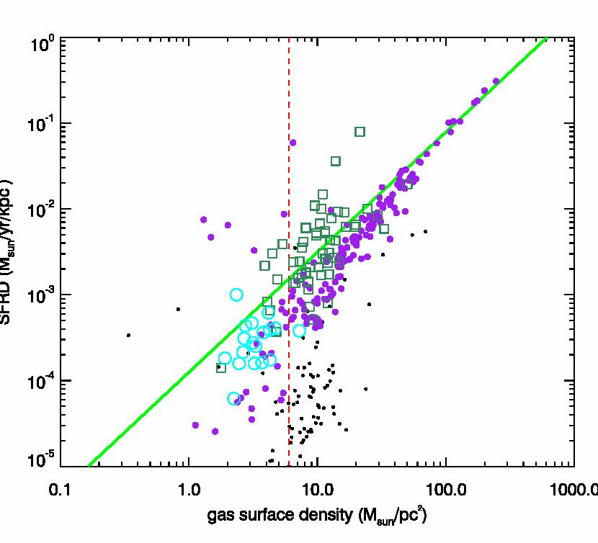
kennicutt-schmidt relation
Kennicutt + threshold
Z-dependent H2-based recipe

Slide 24
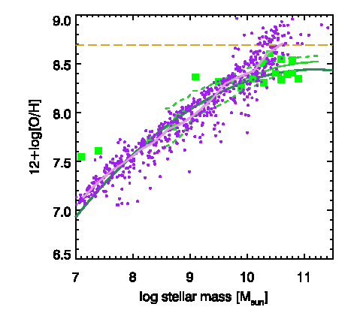
gas phase metallicity
Moustakas et al.
THINGS galaxies
Pilyugin & Thuan
(1995) calibration
renormalized
Tremonti et al. 2004
Maiolino et al. 2008

